Slide 1
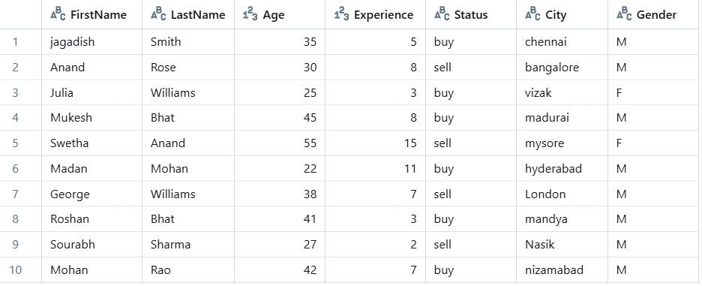


Subtract
Without Duplicates
Output: Only Un-Common Records

Slide 2
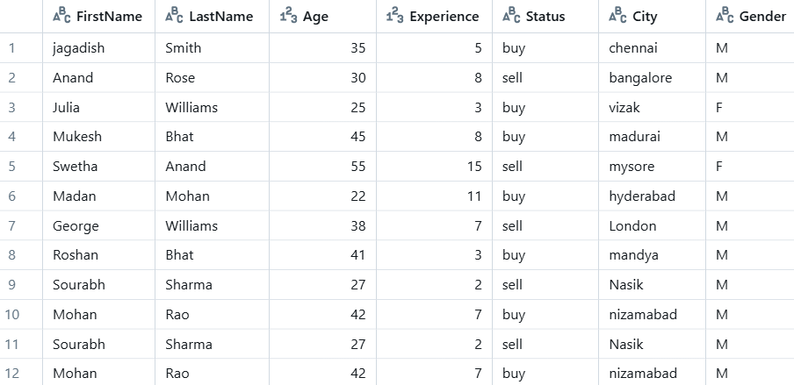


Subtract
With Duplicates Records
Output: Only Un-Common Records

Slide 3
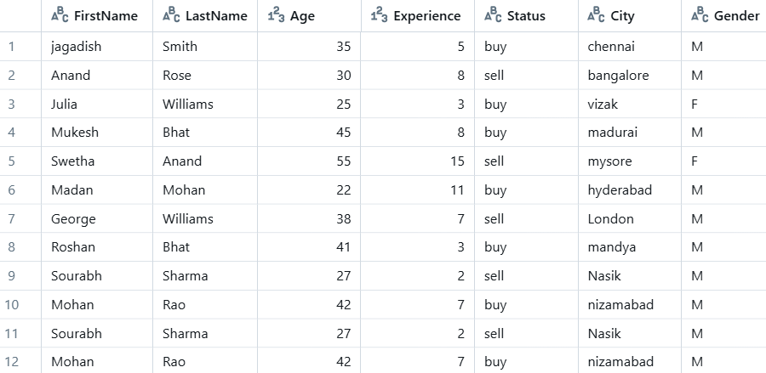

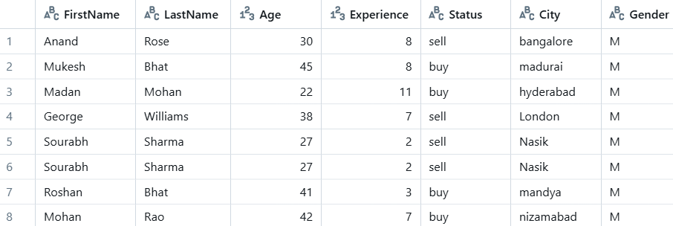
exceptAll
With Duplicates Records
Output: Only Un-Common Records

